Slide 1
When to Start Insulin Therapy ?
Muhammad Abdul-Ghani, MD, PhD
Professor of Medicine, Diabetes Division,
University of Texas Health at San Antonio

Slide 3
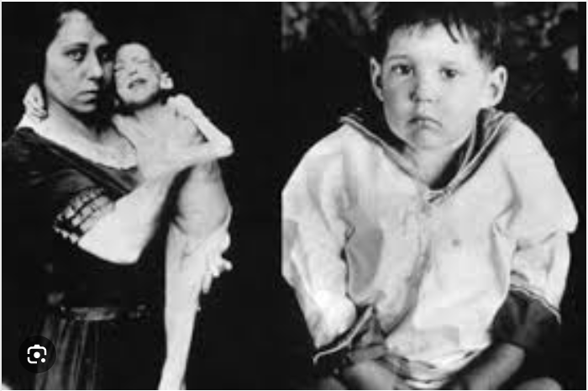
The First Patient to Receive Insulin Injection

Slide 4
Why Insulin in T2DM?
Very effective in lowering plasma glucose
Natural compound, no adverse events
No limit on dose
Impaired insulin secretion is a core defect in T2DM

Slide 5
Limitations of Insulin Therapy
Hypoglycemia
Weight gain
Does not produce durable reduction in HbA1c
Does not address the underlying metabolic defects present in T2DM
No cardiac, renal or hepatic protection

Slide 6
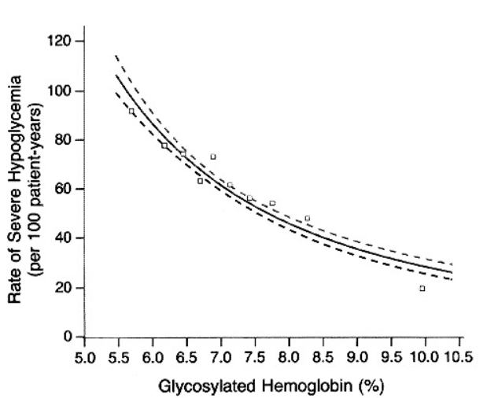
Relationship Between Incidence of Hypoglycemia and HbA1c
N Engl J Med. 353: 2643–2653, 1993.

Slide 7
Limitations of Insulin Therapy
Hypoglycemia
Weight gain
Does not address the underlying metabolic defects present in T2DM
Does not produce Durable reduction in HbA1c
No cardiac, renal or hepatic protection

Slide 8
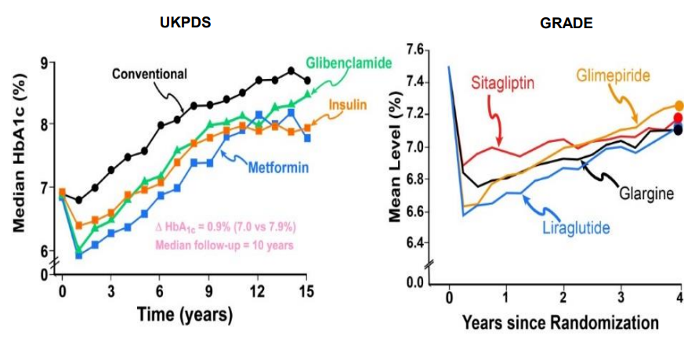
Lack of Durable Reduction in HbA1c by Insulin

Slide 9
Limitations of Insulin Therapy
Limitations of Insulin Therapy
Hypoglycemia
Weight gain
Does not address the underlying metabolic defects present in T2DM
Does not produce Durable reduction in HbA1c
No cardiovascular, renal or hepatic protection

Slide 10
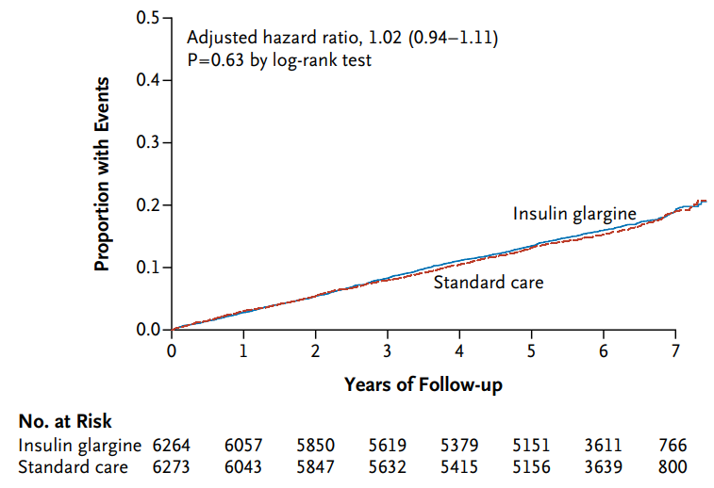
Effect of Glargine on MACE
N Engl J Med 2012;367:319-28

Slide 11
In terms of metabolic control, insulin has special advantage over other glucose lowering drugs

Slide 12
When to Start Insulin Therapy?
Which T2DM Patient needs insulin ?

Slide 13
Natural History of T2DM
300
140
Insulin- Mediated Glucose Uptake (mg/m²•min)
Mean Plasma Insulin During OGTT
(µU/ml)
250
100
200
60
150
20
100
400
Mean Plasma Glucose During OGTT
(mg/dl)
300
200
100
CON
OB-
GLU INTOL
OB-
DIAB
Hi INS
OB-
DIAB
Lo INS
OB

Slide 14
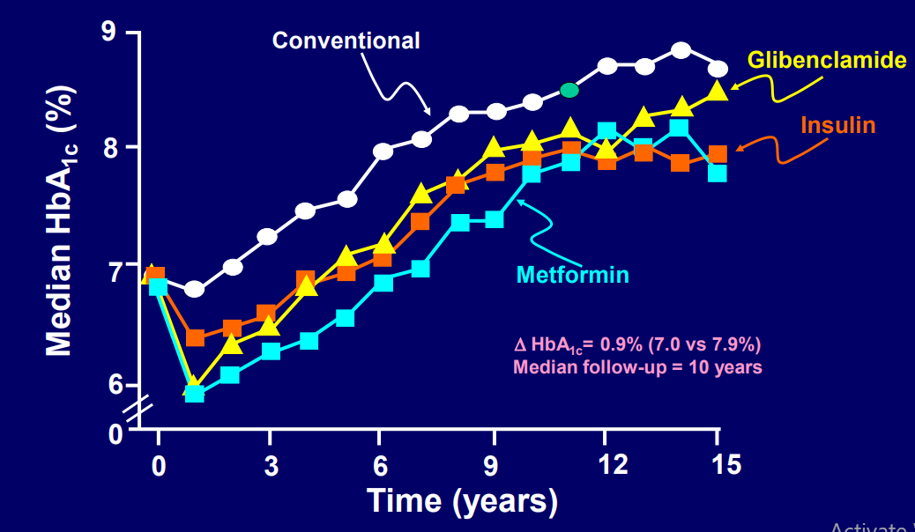
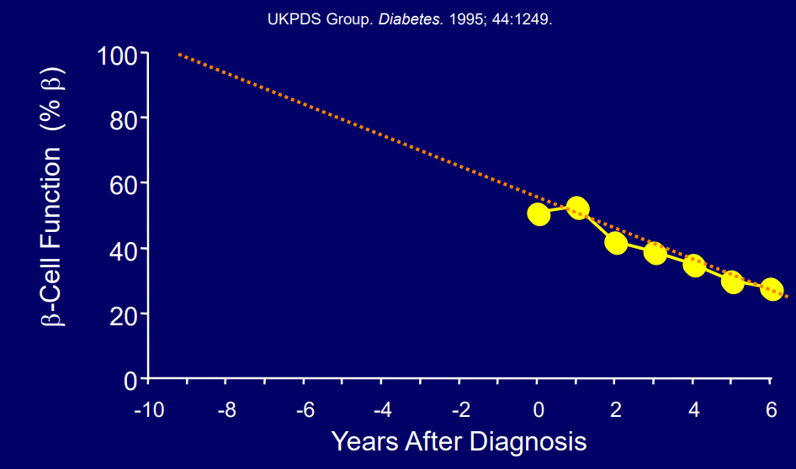
Progressive Beta Cell Failure is the Principal Factor Responsible for the Development and Progression of T2DM

Slide 15
At What Level of Endogenous Beta Cell Function Is Insulin Required in T2DM?

Slide 16
The QATAR Study-Research Design
Poorly Controlled T2DM (>7.5%)
SU + Metformin
Exenatide (QW)
Plus Pioglitazone
Basal-Bolus Insulin
Aim
Maintain HbA1c <7.0%

Slide 17
Baseline Characteristics
Combination Therapy
Insulin Therapy
Number
Age (yrs) Sex (male %) BMI (kg/m²) Diabetes Duration (y) HbA1c (%) FPG (mg/dl)
Background Therapy
Metformin mg(%)
SU
Gliclazide mg (%)
Glimepiride mg(%)
123 52±1 40 31.1±0.5 10.5±0.5
9.9±0.2 231±8
1908 (100)
101 (58)
7.4 (42)
108 52±1 37 30.5±0.5 10.9±0.5
10.0±0.2 237±7
1953 (100)
106 (55)
7.2 (45)

Slide 18
Effect of Therapy on HbA1c in QATAR Study
7.1%
P<0.0001
6.2%

Slide 19
Effect of Combination Therapy on HbA1c Based Upon Baseline HbA1c

Slide 20
Patients Achieving Treatment Goals in QATAR Study
83
50
53
13

Slide 21
Plasma Glucose Conc. During the OGTT in Qatar Study

Slide 22
Plasma Insulin & C-Peptide Concentrations During the OGTT in Responders and Non-responders to Combination Therapy

Slide 23
Predictors of Achieving HbA1c <7.0% in Subjects Receiving Combination Therapy in Qatar Study
 | OR | 95% CI | P-Value
BMI (kg/m²) | 1.10 | 1.01-1.20 | 0.03
Disease duration (years) | 0.876 | 0.78-0.98 | 0.02
Matsuda Index | 0.749 | 0.61-0.93 | 0.007
% increase in 2h C-peptide above fasting | 33.0 | 5.30-205 | <0.0001

Slide 24
CPEP120/CPEP0 >1.6 82% Sensitivity 79% specificity
Cut Point for CPEP120/CPEP0 For Response to Therapy

Slide 25
How About Newly Diagnosed T2DM?

Slide 26
EDICT Study
318 Drug naïve, newly diagnosed T2DM patients
Randomized to receive:
-Initial combination with metformin + pioglitazone +GLP-1 RA
- Metformin sequentially followed by glipizide and basal insulin
Patients followed for 3 years
Treatment goal: HbA1c <6.5%

Slide 27
Time-Change in HbA1c in EDICT

Slide 28
Patients Achieving HbA1c < 6.5% and <7.% in EDICT

Slide 29
Plasma CPEP During the OGTT

Slide 30
Prediction of Requirement to Insulin by Insulin Secretion and Insulin Sensitivity

Slide 31
CPEP120/CPEP0 Predicts Requirement to Insulin in Newly Diagnosed T2DM Patients
C-Pep₁₂₀/C-Pep₀
<1.78
1.78-2.65
>2.65
Required Insulin
Met + SU
or
Met+GLP-1 RA+TZD
Metformin

Slide 32
What About Newly Diagnosed T2DM Patients With HbA1c >10%?

Slide 33
Time-Change in HbA1c in Patients with HbA1c >10%

Slide 34
Plasma CPEP During the OGTT Predicts Requirement for Insulin Therapy in Newly Diagnosed T2DM

Slide 35
CPEP120/CPEP0 Predicts Requirement to Insulin in Newly Diagnosed T2DM Patients With HbA1c >10%
Newly Diagnosed T2DM
HbA1c >10%
CPEP₁₂₀/CPEP₀
< 1.7
> 1.7
Met+TZD+GLP1 RA
Or
Metformin + SU
FPG Conc.
>269 mg/dl
<269 mg/dl
Required Insulin
Met+TZD+GLP1 RA

Slide 36
Summary
Insulin is very effective in lowering the plasma glucose concentration
Associated with significant adverse events, weight gain and hypoglycemia
Dose not correct the underlying defects responsible for hyperglycemia
Lack of durable reduction in the HBA1c
Lack of cardiovascular and direct renal protection
Only patients require insulin for metabolic control (i.e. HbA1c <7.0%) should receive insulin therapy
CPEP120/CPEP0 <1.7 is a useful tool to identify subjects require insulin to achieve the glycemic goal

